Slide 1
Digital Portfolio
STUDENT NAME :ASHKAR.A
REGISTER NO AND NMID: asbruce2428c0549
DEPARTMENT: BSc AI & ML
COLLEGE: JCT College of Arts And Science

Slide 2
Personal Digital Portfolio Website

Slide 3


AGENDA
Problem Statement
Project Overview
End Users
Tools and Technologies
Portfolio design and Layout
Features and Functionality
Results and Screenshots
Conclusion
Github Link
3/21/2024 Annual Review

Slide 4

PROBLEM STATEMENT
In today’s competitive digital era, a traditional resume alone is not enough to highlight the true potential of a web developer. Recruiters and clients increasingly prefer to see practical demonstrations of skills through real projects, interactive designs, and user-friendly applications. Many students, however, struggle with creating a professional online presence, which limits their ability to effectively showcase their talents. This lack of visibility often results in missed opportunities for internships, jobs, and freelance work. To overcome this challenge, there is a need for a digital portfolio website that can present skills, projects, and achievements in a more engaging and professional manner.

Slide 5

PROJECT OVERVIEW
This project is a personal portfolio website developed to showcase my skills, projects, and contact details. It is designed with a clean and responsive layout, making it accessible across devices. The portfolio includes sections such as About Me, Projects, and Contact, and highlights real-world applications like a Todo App, Weather Dashboard, and Blog Platform. It serves as a digital resume that creates a strong professional presence.

Slide 6

WHO ARE THE END USERS?
Recruiters & Hiring Managers – to evaluate skills and projects
Clients – looking for freelance or project-based developers
Faculty & Evaluators – for academic assessments
Peers & Collaborators – to connect and work on projects

Slide 7

TOOLS AND TECHNIQUES
Frontend Languages:
HTML5 – Structure of the website
CSS3 – Styling and responsive design
JavaScript (Vanilla JS) – Interactivity and dynamic section handling
Design Tools:
Figma / Canva – For UI/UX mockups and design planning
Version Control & Deployment:
Git & GitHub – Source code management and hosting
GitHub Pages / Netlify – Deployment of the portfolio
Other Technologies (optional):
Responsive Web Design Principles
Google Fonts (Poppins) for typography

Slide 8
POTFOLIO DESIGN AND LAYOUT
Theme & Color Palette
Soft cream and beige tones for a warm, professional look
Brown & goldish accents for headings and highlights
Layout Structure
Header: Name & Role (Web Developer | Designer)
Navigation Bar: Easy access to About, Projects, Contact
Sections:
About Me – Brief intro & skills
Projects – Showcase with description & features
Contact – Email & interaction button
Typography
Poppins font for modern and clean readability
Visual Elements
Rounded cards for projects with hover effects
Box shadows for depth and neat separation
Responsive design for desktop & mobile devices
User Experience (UX)
Minimal, clean, and user-friendly interface
Smooth hover transitions & section highlights
8

Slide 9
FEATURES AND FUNCTIONALITY
Navigation System
Dynamic section switching (About, Projects, Contact) using JavaScript
Clean and intuitive navigation bar
About Section
Personal introduction & professional background
Clear presentation of skills and interests
Projects Showcase
Organized project cards with title, description, and technologies
Hover animations for interactivity
Highlighted major works: Portfolio Website, Todo App, Weather Dashboard, Blog Platform
Contact Section
Direct email link for communication
Interactive “Send Message” button with alert feedback
UI/UX Enhancements
Smooth hover effects & transitions
Responsive layout for different devices
Warm & professional color palette for readability
.

Slide 10
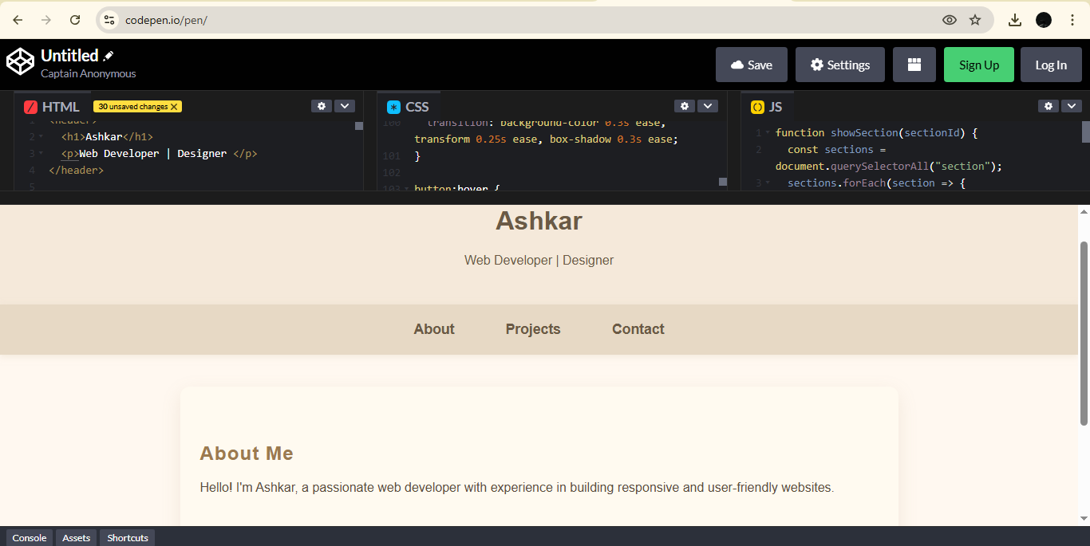

RESULTS AND SCREENSHOTS
3/21/2024 Annual Review
10

Slide 11
CONCLUSION
The project resulted in a professional and responsive digital portfolio that effectively showcases my skills, projects, and contact details.
Demonstrated proficiency in frontend web technologies and applied UI/UX best practices to create an engaging user experience.
Enhanced my ability to design, develop, and deploy a real-world web application.
This portfolio stands as a personal brand identity and a stepping stone for career growth and future opportunities.
11

Slide 12
CONCLUSION
https://github.com/ashkar765-del/nm.git
12

